Slide 1

Green Pace
Security Policy Presentation
Developer: Fernando Lomeli

Slide 2

OVERVIEW: DEFENSE IN DEPTH
Green Pace's security policy showcases a set of principles and coding standards. It is needed for securing the organization's safety and defending against vulnerabilities. The policy itself is one of the first steps for defense-in-depth as it outlines some of the layers of security.

Slide 3
THREATS MATRIX
Likely – Likely/probable that ignoring the standard could lead to an exploitable vulnerability
Unlikely – Unlikely that ignoring the standard could lead to an exploitable vulnerability
Priority – Likely with high severity
Low priority – Unlikely with low/medium severity
Likely STD-003-CPP STD-004-CPP | Priority STD-002-CPP STD-005-CPP STD-010-CPP
Low priority STD-001-CPP STD-006-CPP STD-007-CPP | Unlikely STD-008-CPP STD-009-CPP

Slide 4
10 PRINCIPLES
Coding standards that apply to each principle.
Validate Input Data | STD-002-CPP; STD-004-CPP; STD-010-CPP
2. Heed Compiler Warnings
3. Architect and Design for Security Policies | STD-007-CPP
4. Keep It Simple | STD-006-CPP; STD-008-CPP
5. Default Deny
6. Adhere to the Principle of Least Privilege
7. Sanitize Data Sent to Other Systems | STD-004-CPP
8. Practice Defense in Depth | STD-010-CPP
9. Use Effective Quality Assurance Techniques | STD-007-CPP
10. Adopt a Secure Coding Standard | STD-001-CPP; STD-002-CPP; STD-003-CPP; STD-005-CPP; STD-006-CPP; STD-009-CPP

Slide 5
CODING STANDARDS
High to low priority in order from top to bottom.
STD-002-CPP Ensure that operations on signed integers do not result in overflow.
STD-010-CPP Prevents more than the allotted number of characters from being read by the console.
STD-005-CPP Do not write to or read from memory once it is freed.
STD-004-CPP Do not log unsanitized user input.
STD-003-CPP Do not attempt to modify string literals.
STD-007-CPP Handle all exceptions.
STD-009-CPP Close files when they are no longer needed.
STD-008-CPP Write constructor member initializers in canonical order.
STD-006-CPP Do not use assertions to verify the absence of runtime errors.
STD-001-CPP Do not create incompatible declarations of the same function or object.

Slide 6
ENCRYPTION POLICIES
Encryption at rest | Encryption at rest works on data at rest, data that isn’t actively traveling, which could be databases or file servers. This data is important and is very valuable to hackers. The data at rest should be encrypted with complex algorithms such as AES-256. This will make it so that even if attackers obtain the data, it will be nearly impossible to decipher without the decryption key.
Encryption in flight | Encryption in flight refers to data traveling from one place to another. This data is at risk of being intercepted and stolen. Encryption in flight involves sensitive data being encrypted as it travels to its destination and being decrypted by the authorized receiver. This allows the data to be inaccessible when intercepted without the decryption key.
Encryption in use | Encryption in use refers to data being accessed or processed by users or software. Data becomes vulnerable at this stage. Encryption in use addresses this vulnerability by encrypting and decrypting data in real-time. This makes it so that data is encrypted during its entire lifecycle along with at rest and in flight so that no attackers can obtain plaintext data.

Slide 7
TRIPLE-A POLICIES
Authentication | Authentication is the process of verifying who someone is or is claiming to be. A user may identify themselves by using proper login credentials such as username, email, and password. New users will be added to the database along with their login credentials. This policy applies because whenever any user logs into the system they must be authenticated and checked with credentials in the database to defend against certain threats.
Authorization | Authorization is the process of determining what services a user is allowed to access. Once the user is authenticated, they are authorized with certain privileges depending on their status. This, along with the principle of least privilege, should keep the system protected by keeping users out of areas they should not be allowed to access.
Accounting | Accounting is the process of keeping track of what resources were accessed by who and at what time. Any files accessed by users or changes to the database can be tracked by session time, date, and which user accessed this data. This policy is beneficial when administrators perform audits to check on any unwanted actions. Tracking changes made to the system is important especially when any issues arise.

Slide 8
Unit Testing
The next few slides will showcase testing using the Google unit testing framework. These tests will be able to identify different coding vulnerabilities for positive and negative results. These tests were run in visual studio. https://learn.microsoft.com/en-us/visualstudio/test/how-to-use-google-test-for-cpp?view=vs-2019

Slide 9
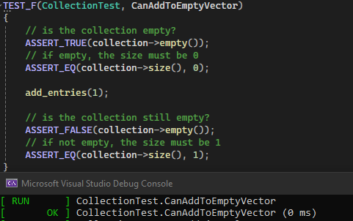
Unit Testing CanAddToEmptyVector
A test to verify adding a single value to an empty collection.

Slide 10
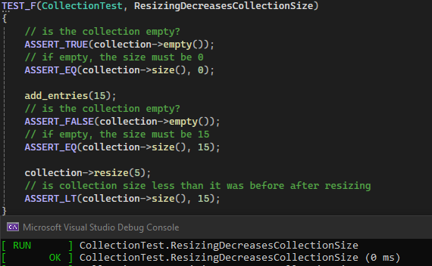
Unit Testing ResizingDecreasesCollectionSize
Verify that resizing decreases the collection size.

Slide 11
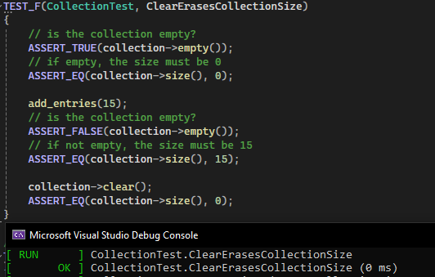
Unit Testing ClearErasesCollectionSize
Verify that using the clear() method erases the collection.

Slide 12
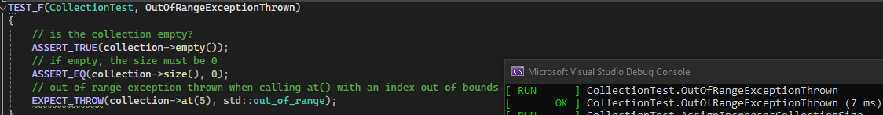
Unit Testing OutOfRangeExceptionThrown
Create a test to verify the std::out_of_range exception is thrown when calling at() with an index out of bounds. This is a negative test.

Slide 13

AUTOMATION SUMMARY

Slide 14
TOOLS
The DevSecOps pipeline displays the two sections beginning in pre-production and continuing to production.
Build - automated tools are implemented in the form of static application security testing
Verify and Test – dynamic application security testing tools
Transition and Health Check – runtime verification tools

Slide 15
RISKS AND BENEFITS
Problems: Dos attacks and data breaches.
Solutions: Shift left security, implement security in all stages of SDLC, automation
It is essential to act early to prevent threats and mitigate vulnerabilities
Risk of waiting could result in damages from attacks or issues being found late which could be more costly to fix.

Slide 16
RECOMMENDATIONS
The entire team should review and understand the principles and coding standards.
The entire team bears some responsibility towards security.
All employees trained in security processes and secure coding practices.
White-hat hackers to find vulnerabilities
White-hate hacker Charlie Miller revealed a vulnerability that allowed him to take over the systems/brake system of Jeep Cherokees https://www.wired.com/2015/07/hackers-remotely-kill-jeep-highway/

Slide 17
CONCLUSIONS
To prevent future problems, the shift left approach should be adopted to start including security as early as possible.
Automation tools should also be included for security testing, vulnerability scanning, and compliance checks.
Technology is always advancing, as such security policies should be constantly reviewed and updated.

Slide 18
REFERENCES
Greenberg, A. (2015, July 21). Hackers Remotely Kill a Jeep on the Highway-With Me in It. Wired. https://www.wired.com/2015/07/hackers-remotely-kill-jeep-highway/
SEI CERT C++ Coding Standard. SEI CERT C++ Coding Standard - Confluence. (n.d.). https://wiki.sei.cmu.edu/confluence/pages/viewpage.action?pageId=88046682
Queen, C. (2024, June 10). DevOps vs DevSecOps: Understanding the Difference. CrowdStrike. https://www.crowdstrike.com/en-us/cybersecurity-101/cloud-security/devops-vs-devsecops/
Zettler, K. (n.d.). DevSecOps Tools. Atlassian. https://www.atlassian.com/devops/devops-tools/devsecops-tools

